Slide 1





Remote Sensing Image Classification Using Down Sampled RSI-CB256
Deep Learning with PyTorch Capstone Project
By Karthik Manivannan
Fanshawe ID: 1229717
Professor Name: Mohammed Yousefhussien

Slide 2



Table of contents
03
04
05
06
07
09
10
11
12
13
14
17
18
Introduction
Project Objectives
Dataset Description
Dataset Preprocessing
Model Selection and Architecture
Model Training Process
Hyperparameter Tuning
Evaluation
Fine-Tuning and Iteration
Final Model Testing
Results
Conclusion
References

Slide 3


Introduction
The primary goal of this capstone project is to develop and train advanced deep learning models to classify remote sensing images accurately.
These models will be trained using a strategically down sampled version of the RSI-CB256 dataset.
The dataset will be reduced to 15 classes and around 12,500 image samples to facilitate ease of implementation and accommodate available compute power.
This project will leverage convolutional neural networks (CNN’s) to accurately classify various land cover types, showcasing the practical application of deep learning techniques in remote sensing and geospatial analysis.
Additionally, to provide a comparison, we will implement an existing open-source model, ResNet-18, and evaluate its performance against my custom CNN model. This comparison will highlight the strengths and weaknesses of each approach and provide insights into model selection for remote sensing image classification tasks.

Slide 4

Project Objectives
Develop and train deep learning models for classifying remote sensing images using the RSI-CB256 dataset by using Customised CNN and Pre-trained ResNet-18 Models
Goal 01
Goal 02
Goal 03
Dataset Reduction:
Reduce the dataset to 15 classes and around 12,500 images to facilitate ease of implementation and accommodate available compute power.
Model Comparison:
Compare the performance of a Custom CNN with ResNet-18 to understand strengths and weaknesses in remote sensing image classification.
Deep Learning Techniques:
Showcase the practical application of advanced deep learning techniques in remote sensing and geospatial analysis, contributing valuable insights to the field.

Slide 5

Dataset Description
RSI-CB256 Dataset:
The RSI-CB256 dataset, a high-quality remote sensing
image collection, is designed for land cover classification tasks.
The original dataset contains 24,747 high-resolution satellite
images.
The original RSI-CB256 dataset contains 45 classes, categorized
into various land cover classes
Downsampling:
Reduced to 15 distinct classes to streamline the classification process.
Reduced to approximately 12,500 images, balancing the dataset while maintaining class diversity.
Each image in the dataset is resized to a consistent 256x256 pixels resolution, ensuring uniformity for model training and evaluation.

Slide 6

Dataset Preprocessing
Resizing Images
All images resized to a consistent resolution of 256x256 pixels to standardize input for the model.
Normalizing Pixel Values
Pixel values normalized to have a mean of [0.485, 0.456, 0.406] and standard deviation of [0.229, 0.224, 0.225] for the three color channels, enhancing the model's ability to learn effectively.
Data Augmentation
Techniques such as random horizontal flipping, random rotation, and random resized cropping applied to increase the diversity of the training data and improve model generalization.
Splitting Dataset
The dataset split into training (80%), validation (10%), and test sets (10%) to facilitate model training and evaluation.

Slide 7


Model Selection and Architecture
Custom CNN Architecture
Feature Extraction Layers:
Three convolutional layers:
1st Layer: 64 filters, kernel size 3x3, stride 1, padding 1.
2nd Layer: 128 filters, kernel size 3x3, stride 1, padding 1.
3rd Layer: 256 filters, kernel size 3x3, stride 1, padding 1.
Each convolutional layer followed by ReLU activation and max pooling (kernel size 2x2, stride 2).
Classification Layers:
Fully connected layers:
1st Layer: 256 * 32 * 32 input features, 1024 output features.
2nd Layer: 1024 input features, 15 output features (one for each class).
Dropout applied after the first fully connected layer to prevent overfitting.

Slide 8

Model Selection and Architecture
ResNet-18 Architecture
Pre-trained Model:
Utilizes the ResNet-18 architecture from the PyTorch torchvision.models library.
Known for its residual learning framework, which helps in training deep networks.
Classification Layers:
Fully connected layers:
The fully connected layer adapted to output 15 classes instead of the original 1000 classes.

Slide 9


Model Training Process
01
02
03
04
Dataset Split:
Hyperparameters:
Optimization & Scheduling:
Regularization & Monitoring:
The downsampled dataset of 12,500 images was split into:
Training (80%)
Validation (10%)
Test (10%)
This ensures robust evaluation and prevent overfitting.
Learning Rates - Tested with 0.001 and 0.0005.
Batch Sizes - Evaluated with 64 and 128.
Epochs - Both models were trained for 10 epochs.
Adam optimizer was used for both models.
StepLR scheduler with a step size of 7 and gamma of 0.1 to adjust the learning rate.
Training progress was monitored using loss and accuracy metrics for both training and validation sets.
Applied dropout in the classifier layers to prevent overfitting.

Slide 10
Hyperparameter Tuning
Learning Rates:
Experimented with two learning rates: 0.001 and 0.0005.
Purpose: To find the optimal learning rate that balances between convergence speed and stability.
Batch Sizes:
Evaluated with batch sizes of 64 and 128.
Purpose: To determine the best batch size for efficient training and memory usage.
Performance Metrics:
Accuracy, precision, recall, and F1-score were recorded for each combination of hyperparameters.
To identify the hyperparameter set that yields the best overall performance.

Slide 11

Model Validation
Validation Metrics:
Accuracy, Precision, Recall and F1-Score were used.
Validation Results:
Custom CNN: Achieved a validation accuracy of 96.80% with 128 batch size but i chose 64 batch size with validation accuracy of 96.24% as it was more stable and reliable, with precision, recall, and F1-score metrics closely aligned.
ResNet-18: Achieved a validation accuracy of 99.12%, indicating superior performance in comparison to the custom CNN.
Confusion Matrix:
I generated confusion matrices to visualize the performance across different classes, helping us identify which classes were commonly misclassified.
Analyzing these misclassifications provided insights into potential areas for model improvement.

Slide 12

Fine-Tuning and Iteration
Model Adjustments
Experimented with various learning rates and batch sizes to find the optimal settings. This helped enhance the model's performance significantly
Adjustments were made to the number of layers and neurons to improve the model’s capacity to learn complex patterns in the data
Iteration Process
After each training iteration, we evaluated the models using validation data. The feedback from these evaluations guided further adjustments and fine-tuning.
To prevent overfitting, we implemented dropout in the model layers
Improvements
Each round of fine-tuning brought incremental improvements in model accuracy and generalization.
Through iterative training and fine-tuning, the models reached a point of convergence, indicating an optimal performance level.

Slide 13

Final Model Testing
Custom CNN Model Performance:
On the test dataset, the Custom CNN model achieved:
Accuracy: 95.52%
Precision: 95.62%
Recall: 95.52%
F1-Score: 95.52%
These results indicate a strong and consistent performance across different metrics, demonstrating the model's reliability in classifying unseen data.
ResNet-18 Model Performance:
On the test dataset, the ResNet-18 model achieved:
Accuracy: 98.80%
Precision: 98.80%
Recall: 98.80%
F1-Score: 98.80%
These results highlight the superior performance of ResNet-18, confirming its
robustness and effectiveness for remote sensing image classification tasks.

Slide 14



Results
01
Training Performance
Custom CNN Model:
Best Configuration:
Learning Rate: 0.0005, Batch Size: 64
Epoch 0: Train Loss: 0.1732, Val Loss: 0.1930, Train Acc: 94.39%, Val Acc: 94.56%
Epoch 9: Train Loss: 0.0571, Val Loss: 0.1540, Train Acc: 98.17%, Val Acc: 95.84%
ResNet-18 Model:
Best Configuration:
Learning Rate: 0.0005, Batch Size: 64
Epoch 0: Train Loss: 0.0467, Val Loss: 0.0464, Train Acc: 98.52%, Val Acc: 98.48%
Epoch 9: Train Loss: 0.0067, Val Loss: 0.0300, Train Acc: 99.76%, Val Acc: 99.44%
02
Hyperparameter Tuning
Optimal Hyperparameters:
Learning Rate: 0.0005
Batch Size: 64

Slide 15
Results
03
Validation Performance
Custom CNN:
Acc: 96.24%, Precision: 96.23%, Recall: 96.24%, F1-Score: 96.21%
ResNet-18:
Acc: 99.12%, Precision: 99.13%, Recall: 99.12%, F1-Score: 99.12%
04
Test Performance
Custom CNN:
Accuracy: 95.52%, Precision: 95.62%, Recall: 95.52%, F1-Score: 95.52%
ResNet-18:
Accuracy: 98.80%, Precision: 98.80%, Recall: 98.80%, F1-Score: 98.80%

Slide 16
Results
05
Training and Validation Loss Plot
Custom CNN:
Shows consistent decrease in both training and validation loss, indicating effective learning and minimal overfitting.
ResNet-18:
Demonstrates rapid convergence with low training and validation loss, reflecting superior performance and generalization.
06
Prediction Samples
Custom CNN:
Displays correct and incorrect predictions on the validation set, highlighting areas for potential improvement.
ResNet-18:
Displays accurate predictions with minimal errors, showcasing its robustness in remote sensing image classification.

Slide 17
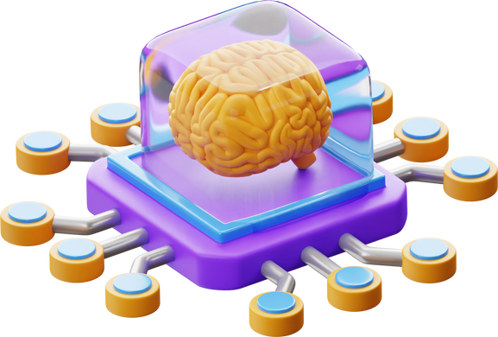
Conclusion
Key Findings:
ResNet-18 outperformed the custom CNN in terms of accuracy and all other metrics, demonstrating its effectiveness for this task.
Both models successfully leveraged deep learning techniques to classify remote sensing images, showcasing their practical applications.
Challenges:
Handling and processing the large dataset required efficient data management and computational resources.
Fine-tuning hyperparameters was critical to achieving optimal performance.
Future Work:
Explore more advanced architectures and fine-tuning techniques.
Incorporate additional data augmentation methods to further enhance model robustness.
Experiment with other remote sensing datasets to validate and generalize findings.
Final Conclusion:
My project successfully demonstrated the application of deep learning for remote sensing image classification.
ResNet-18 provided superior performance, indicating its suitability for such tasks.
Future work will focus on expanding model capabilities and exploring additional datasets for broader usage.

Slide 18
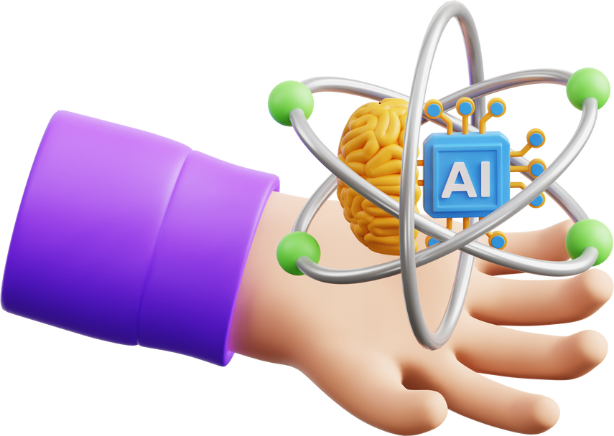
References:
INFO6147 Deep Learning with Pytorch Course Materials and Jupyter Notebooks.
https://www.datacamp.com/tutorial/introduction-to-convolutional-neural-networks-cnns
https://towardsdatascience.com/understanding-and-visualizing-resnets-442284831be8
https://billtcheng2013.medium.com/image-classification-with-transfer-learning-on-pytorch-2d718c85b58f
ResNet-18:
https://waww.geeksforgeeks.org/introduction-convolution-neural-network/
https://medium.com/@sasirekharameshkumar/deep-learning-basics-part-8-convolutional-neural-network-cnn-4cff567bad46
https://medium.com/@navarai/unveiling-the-diversity-a-comprehensive-guide-to-types-of-cnn-architectures-9d70da0b4521
https://www.datacamp.com/courses/deep-learning-for-images-with-pytorch
https://towardsdatascience.com/grid-search-for-model-tuning-3319b259367e
https://medium.com/pythoneers/hyperparameter-tuning-in-data-science-ad1a03d830b9
https://www.datacamp.com/tutorial/complete-guide-data-augmentation
javatpoint.com/data-augmentation-in-machine-learning
https://github.com/bentrevett/pytorch-image-classification
https://github.com/PacktPublishing/Deep-Learning-for-Computer-Vision
https://towardsdatascience.com/cnn-transfer-learning-fine-tuning-9f3e7c5806b2
https://rumn.medium.com/part-1-ultimate-guide-to-fine-tuning-in-pytorch-pre-trained-model-and-its-configuration-8990194b71e

Slide 19

References:
https://medium.com/womenintechnology/data-preprocessing-steps-for-machine-learning-in-phyton-part-1-18009c6f1153
https://towardsdatascience.com/understanding-and-visualizing-resnets-442284831be8
https://neptune.ai/blog/data-preprocessing-guide
https://www.analyticsvidhya.com/blog/2019/08/11-important-model-evaluation-error-metrics/
https://medium.com/@zhonghong9998/evaluating-model-performance-a-comprehensive-guide-6f5e7c11409f
https://towardsdatascience.com/good-approach-to-evaluate-your-machine-learning-model-e2e1fd6aa6bb
https://github.com/anubhavparas/image-classification-using-cnn
https://github.com/sinanw/cnn-image-classification
https://github.com/jeffprosise/Deep-Learning/blob/master/Image%20Classification%20(CNN).ipynb
https://github.com/rishivar/Resnet-18
https://github.com/openvinotoolkit/open_model_zoo/blob/master/models/public/resnet-18-pytorch/
https://github.com/Moddy2024/ResNet-18
https://www.kaggle.com/datasets/mahmoudreda55/satellite-image-classification
https://github.com/lehaifeng/RSI-CB
https://huggingface.co/datasets/jonathan-roberts1/RSI-CB256
https://www.kaggle.com/code/priyanksanghvitech/satellite-image-classification-using-cnn
https://aitlas.readthedocs.io/en/latest/examples/multiclass_classification_example_rsi_cb256.html
https://www.researchgate.net/figure/Confusion-matrices-for-the-RSI-CB256-dataset-a-validation-b-testing_fig2_355752357

Slide 20


Thank You!
Capstone Project Submitted By
Karthik Manivannan
Student Id:
1229717

